Slide 1
Disclosure
A Program Preparing Clinicians to Disclose to Patients and Families
The training materials were developed through collaborative testing of SPS hospitals dedicated to improving the disclosure process

Slide 2
Individual Hospital Responsibility
This document is created to provide guidance to start disclosure work – and is not able to meet all local requirements. As such, each individual hospitals must be responsible to do the following:
Adjust this training to ensure alignment with your hospital policies
Ensure this training is compliant with your governing bodies and all applicable regulations

Slide 3
Learning Objectives
Explain the steps to disclose safety event information when medicine and technology fail
Identify how to express empathy and be pro-active with a grieving family
Recognize what to say and how to say it when conversing with the patients and families about an event
Demonstrate how to maintain ongoing, open communication with patients and families after an event

Slide 4
Workshop Agenda (Full)
Topic | Facilitator | Length
Welcome and Introductions | TBD | 10 mins
Background | TBD | 15-30 mins
Teaching Slides Disclosure HUDDLE TIPS for a Respectful Disclosure Disclosure CONVERSATION Post Disclosure DEBRIEFING Medical Record DOCUMENTATION | TBD | 30 mins
Video Activity | TBD | 10 mins
Simulation- Role Play | TBD | 60-110 mins
Wrap-up | TBD | 10-15 mins
Notes:
Use as template

Slide 5
Background
Disclosure

Slide 6
Select 1 Video
A Parent Perspective Story Behind the Disclosure of an event . . .
“Please See Me” a video released by MedStar Health that focuses on the ideal of open, honest communications in health care.
“Alyssa’ Story: Including Patients and Families in Delivery of Care” a video released by MedStar featuring Alyssa’s mom Carole Hemmelgarn, MedStar Health Patient and Family Advisory Council for Quality and Safety, shares the value of including patients and families in the delivery of care, especially when things don’t go as expected.
Its recommend to stop this video about ½ way through
Michelle Malizzo – “You Won’t Wake Up” a video of the Malizzo Family sharing the story of their adult daughter who suffered from an unexpected event during surgery at the 2011 QaulityNet Conference in Baltimore, MD on December 13th, 2011.
Leilani Schweitzer’s TEDx University of Nevada: Transparency, Compassion, and Truth in Medical Errors The human element can give us kindness and compassion; it can also give us what we don't want— mistakes and failure. Leilani Schweitzer's son died after a series of medical mistakes. In her talk she discusses the importance and possibilities of transparency in medicine, especially after preventable errors. And how truth and compassion are essential for healing.

Slide 7
The “WHYs” of Disclosure Training
Clinicians are required to do this; yet, are not trained
This forces clinicians to essentially learn and practice disclosure in front distressed families
Clinicians sometimes aren’t sure what is ok or not ok to say
To learn how to show and express empathy

Slide 8
The “WHYs” of Disclosure Training
Can strengthen and mend the trusting relationship with the patient and family
Provides transparency for the next steps of care
Strengthens partnerships with patient and families on care decisions and improves outcomes
Healthcare workers believe that clinicians should disclose to patients

Slide 9
“ . . . You need to know what to do when medicine, processes and technology fail and you have to deal with an angry and grieving family.
Running away is unacceptable.
Saying things in the wrong context is unacceptable.
You need to know what to say and how to say it.
You need to know how to stay connected with your patients and families after an adverse event.”
Doug Wojcieszak; Founder: Sorry Works!

Slide 10
Following an Event, Patients and Families Want . . .
Timely communication
The TRUTH
The Facts
Emotional First-Aid
Empathy and compassion
Recognition and validation of emotions
Non-abandonment: silence and evasion breed distrust and compound grief What we hear: “What we needed was for someone to reach out and connect with us in human terms.”
Accountability, including blameless apology
Future Prevention
Remediation

Slide 11
Following an Event, Patients and Families Want . . .
What’s the families perspective?
Perspective:
“(There are) three (potentially avoidable) deadly sins . . . :
(1) You may be busy with lots of cases, but this is the only case that matters to this family.
(2) You don’t have to have something new to report to touch base, see how they are doing, and see if you can help them.
(3) Just because a family doesn’t call, don’t assume everything is OK.”
Doug Wojcieszak; Founder: Sorry Works!

Slide 12
Disclosure Process Map
Stabilize and attend to the medical needs of the patient
Recognized potential deviation of an unexpected event that could lead to potential harm
Notify institution:
Risk consultation
Activate crisis management team, if needed
Sequester involved equipment, materials, and medications
Initial investigation to determine facts
Disclosure Huddle
Develop disclosure plan to the family
ID person to notify the family & JIT training for initial blameless apology
ID ongoing family staff contact
Disclosure Conversation
Blameless apology and disclosure of medical facts regarding the unexpected event to the family including mitigation plan
Post Disclosure Debriefing
Confirm next steps and prepare for documentation
Medical Record Documentation
Document family disclosure in the EMR and follow any regulatory notification requirements
Establish ongoing family contact and ask the family’s preference
Follow-up communication with the family
Formal investigation by institution (RCA/ACA)
Activation of support and 2nd victims
Share formal investigations results with the family
Determine level of harm
Process start/stop
Completed investigation and communication to relevant parties
Active improvement
Ver: 12/8/2016
Future improvement

Slide 13
Disclosure Training Outline
1. Disclosure HUDDLE
2. TIPS for a Respectful Disclosure
3. Disclosure CONVERSATION
4. Post Disclosure DEBRIEFING
5. Medical Record DOCUMENTATION

Slide 14
Disclosure HUDDLE

Slide 15
Disclosure HUDDLE
PURPOSE:
To gather and review facts of an event to develop and practice an organized plan to inform the patient and family.

Slide 16
Disclosure HUDDLE
Components:
General Information
Event FACTS
Family Perspective
Disclosure Notifications

Slide 17
Disclosure HUDDLE
a) General information
Date / Time / Location of Huddle
Hospital Attendees / Role
ID “Just-In-Time” (JIT) Disclosure Coach
ID Initial Disclosure Spokesperson
Patient Name / Age / Gender / MRN / PMH
ID Legal Guardian(s)
Family Member Names / Relationship
Language Interpreter Need
Notes:
Select relevant specialties (pharmacy, radiology, pathology . . . ) to participate in the Disclosure Huddle and Conversation.
Individuals who are effective Disclosure Spokespersons: demonstrate empathy, sincerity, honesty, active listening skills, patience during stressful situations, tact and diplomacy, emotional maturity and self-awareness by withstanding anger / criticism / accusations / blame without becoming defensive, ability to adapt non-verbal expression and body language to the situation, use of non-technical language, a singular focus on the patient’s / family’s interests; conveyance of a “we” message, sufficient clinical knowledge and experience to answer questions, and professional demeanor and authority.
IF the disclosure spokesperson is too distraught, identify someone with a neutral position to do the disclosure (with – e.g. JIT Coach, a physician with a relationship with the family, an RN with a leadership position (avoid RN involved in the event).

Slide 18
Disclosure HUDDLE
b) Event FACTS
Patient’s current status
Description of the event (FACTS)
What service(s) was / were involved with the event
Timeline of the event: When / where did the event happen

Slide 19
Disclosure HUDDLE
b) Event FACTS
When / by whom was the event recognized
When / by whom / to whom was the event reported
What is NOT known
Current patient treatment plan
Future concerns / treatment plan

Slide 20
Disclosure HUDDLE
c) Family Perspective
Is the family aware of the event
If aware, what happened from the family’s perspective
Anticipated questions / comments / feedback / concerns from family
Needed family support(s) (e.g. – chaplain, food, lodging, transportation, phone calls, social, Child Life)

Slide 21
Disclosure HUDDLE
d) Disclosure Notifications
Notification of patient’s attending / PCP
Is hospital Leadership needed
Is a risk management / legal consultation needed
Is a quality & patient safety consultation needed
Does security need to be present for the event disclosure

Slide 22
Disclosure HUDDLE
d) Disclosure Notifications
Identify an ongoing hospital “Point Person” for the family:
To establish a consistent and stable relationship between the family and provider entity;
To communicate regularly with the family regarding the progress of the event review; and
To assist the family in obtaining supportive care.
Identify a disclosure meeting site (quiet/confidential; pagers/cell phones off; adequate seating; tissues, paper, pen, and water available)
Notes:
Simple acts of communication and offers of additional customer service can keep the hospital – family relationship open and productive.
Consider alerting “downstream staff” of the event by flagging the EMR (e.g. – orange header strip) and/or placing an “event identifier” on the patient’s hospital room door (so that ALL hospital personnel are aware).

Slide 23
This document is created to provide guidance to start disclosure work – and is not able to meet all local requirements. As such, each individual hospitals must be responsible to do the following:
Adjust this training to ensure alignment with your hospital policies
Ensure this training is compliant with your governing bodies and all applicable regulations

Slide 24
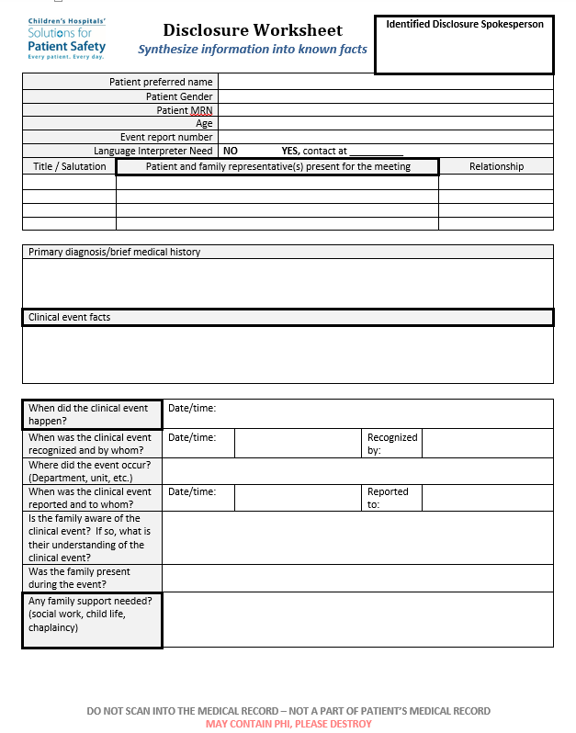
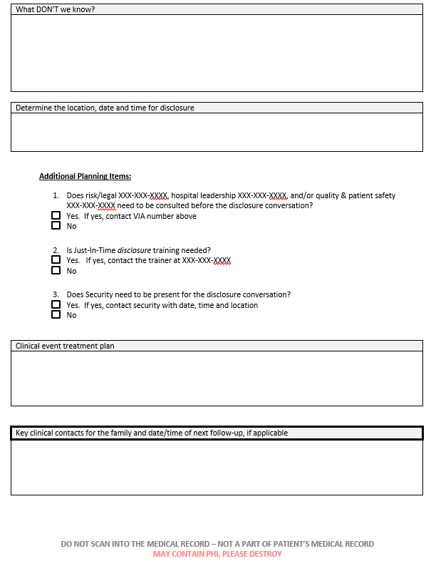
Complete: Disclosure Worksheet
How would you complete this worksheet?
Notes:
Note: Expected that this is printed for each participant, readable, zoomed, slides are hidden next
This document is created to provide guidance to start disclosure work – and is not able to meet all local requirements. As such each individual hospitals must be responsible to do the following:
Adjusts this training to ensure alignment with your hospital polices
Ensure this training is compliant with your governing regulations

Slide 25
Notes:
This document is created to provide guidance to start disclosure work – and is not able to meet all local requirements. As such each individual hospitals must be responsible to do the following:
Adjusts this training to ensure alignment with your hospital polices
Ensure this training is compliant with your governing regulations

Slide 26
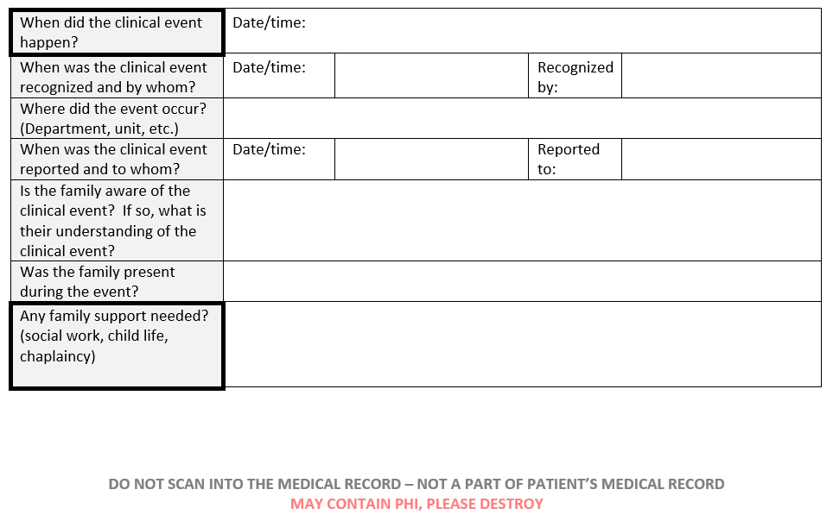
Notes:
This document is created to provide guidance to start disclosure work – and is not able to meet all local requirements. As such each individual hospitals must be responsible to do the following:
Adjusts this training to ensure alignment with your hospital polices
Ensure this training is compliant with your governing regulations

Slide 27
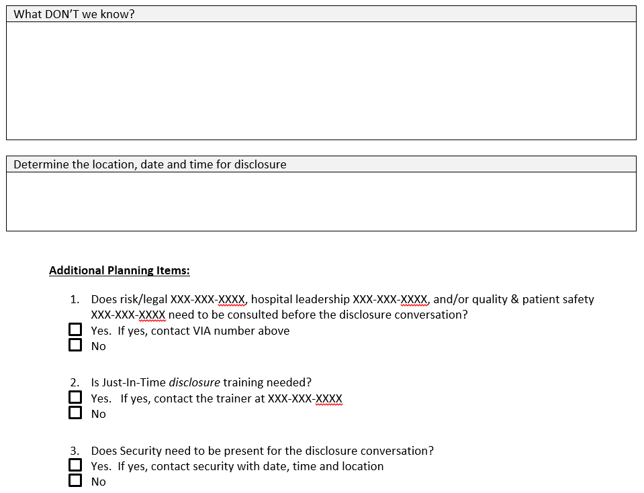
Notes:
This document is created to provide guidance to start disclosure work – and is not able to meet all local requirements. As such each individual hospitals must be responsible to do the following:
Adjusts this training to ensure alignment with your hospital polices
Ensure this training is compliant with your governing regulations

Slide 28
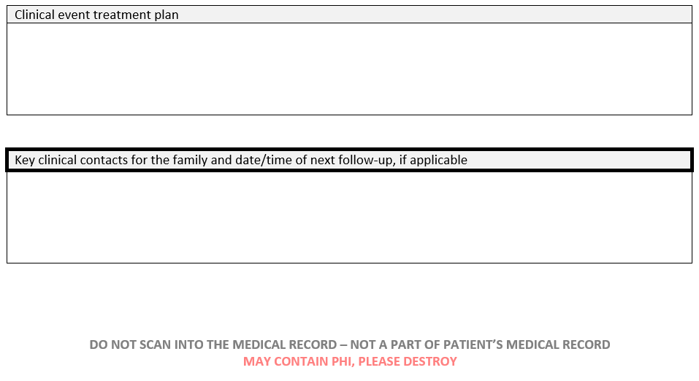
Notes:
This document is created to provide guidance to start disclosure work – and is not able to meet all local requirements. As such each individual hospitals must be responsible to do the following: Adjusts this training to ensure alignment with your hospital polices
Ensure this training is compliant with your governing regulations

Slide 29
TIPS for a Respectful Disclosure

Slide 30
Disclosure TIPS
Respond immediately: “RUN TO THE FIRE (the problem) . . . NOT the door”; “Stop the bleeding and start the HEALING.”
Use honest and candid communication. Overcome the “wall of silence”
Use plain language; no medical jargon
Disclose KNOWN FACTS.
Avoid speculation / hasty conclusions / dispersion of blame.
Notes:
Speculation can result in statements that are later found to be erroneous or needlessly inciting.
Disclosure should happen as close to an event as possible to maximize openness and honesty and minimize situations from getting worse.
Do not blame other areas of the hospital / services for the event.
Do not identify processes that may not have been followed. (Wait for the hospital review of the event to determine causality between the process modification and event).
Do not give information about past failures / experiences. (“We’ve seen this happen before . . . . “)
Do not promise the moon: “All of the medical bills will be waived, and the hospital will pay rehabilitation expenses. You are not Scrooge nor an ATM machine.” If the family asks about expenses, acknowledge their concerns and say that this issue will discussed in the near future once the case review has been completed.

Slide 31
Disclosure TIPS
Express concern & EMPATHY
Sincerely acknowledge the patient’s / family’s suffering.
EMPATHY | APOLOGY
Is NOT an admission of fault | IS an admission of fault
ABSENCE of empathy is one of the chief drivers of litigation. Be quick to empathize. Appropriate 100% of the time. | Only apologize AFTER a review has proven a medical error with causation to the injury / death. Be slow to apologize. Has the power to heal.
“We are sorry this happened . . . We feel badly for you . . . We are going to conduct a review . . How can we help you right now?” | “I am sorry. This is my fault . . . My mistake injured your family member.”
Notes:
Empathy = “blameless apology” → You are not taking the blame for the situation. This is perhaps the most important part of the conversation for the family. It reminds them that you are empathetic to the situation and that you are truly invested in the patient’s care.
Additional examples of EMPATHY:
“It must be difficult that . . . . “
“I regret that _________ occurred.”
“I am sorry that you . . . “
Admitting fault is not always appropriate; get the facts first.

Slide 32
Disclosure TIPS
“Apology is healing when heartfelt and appropriate, potentially inappropriate when it’s premature, and can be divisive when it’s not genuine.”
Taft, 2000 / Lazare, 2005

Slide 33
Disclosure TIPS
NO defensiveness (DEFEND and DENY is NO longer an acceptable disclosure technique)
Express humility
Concede imperfection
Use good body language:
Sit down
Lean forward
Put your hands on your lap
Maintain good eye contact
Speak slowly
65% of a message is interpreted based upon
the NON-VERBAL delivery.
Notes:
“Broken record” – Repeat your message with care, patience and compassion. Every time you repeat the message, the family is going to hear more of what you need for them to hear.
IF it is time to transition . . . “You are asking great questions. I want to be sure we get some answers for you. Right now, I’m sorry, I don’t have any more answers than what I have already shared. As we talked about today, we will keep you up-to-date on what we discover.”
Use of good body language and positive regard (showing appreciation for the family as a way to personalize the experience) are ways to de-escalate and build cooperation.

Slide 34
Disclosure TIPS
Be an active listener:
Employ repetition
Demonstrate patience
Verify patient’s / family’s understanding of information
Speak for the organization / convey a “we” not an “I” message
Allow the patient and family to vent and share feelings and set the “pace” of the conversation
Silent PAUSES are ok during conversation
Notes:
“The wall of silence" – can be a good thing in communication and is known to be of enormous importance in allowing patients/families to synthesize what is being said, allowing reflection, giving "space" before moving to the next part of the conversation, if not the family will not hear anything else.
“Can you tell us what you are thinking?”
“What is your understanding of the event that have happened?”
“What questions can I answer?”
“We don’t have the answers to those questions now, but we will answer them as soon as we can.” In the meantime, we are concentrating on making sure (patient’s name) is stable and continues to progress favorably.”
If threat of a lawsuit is made, acknowledge that legal guidance is everyone’s right. The patient / family should know that the lawsuit would not affect how the care team and hospital provide for the patient. The patient’s healthcare comes first regardless of what happens in the future.

Slide 35
Disclosure TIPS
Invite questions and feedback
Give direct and honest answers to questions
If answers are unknown, state this. Explain your intention to learn more and provide timely updates.
Keep personal feelings in check

Slide 36
Disclosure TIPS
Attempt to understand the patient’s and family’s perspective
Acknowledge and validate the patient’s and family’s feelings
Avoid VAGUE statements → “We’ll get back to you.” (Better statement: “Let’s plan to meet again tomorrow at 2 pm in the Conference Room.”)

Slide 37
Disclosure TIPS – Examples of Responses
Open-ended questions (can’t be answered with “yes” or “no”)
“Would you share with me . . . ?“
“what else may we talk about?”
Clarifying or summarizing comments
“Let me see if I have this right. If I go astray, I’d appreciate it if you would correct me.”
“I want to make sure I understand what you’re telling me.”

Slide 38
Disclosure TIPS – Examples of Responses
Acknowledging comments: HOW, IT’S or THIS
“I can’t imagine how frightening this must feel for you to go through.”
“It’s understandable that you’re vey upset about what’s happened.”
“This is sad and not what any of us expected.”
“ I see the pain that this is causing you.”

Slide 39
Disclosure TIPS – Examples of Responses
Repeaters (repeat a key word)
“Afraid?”
“Upset?”
Continuers (verbal / non-verbal)
Verbal Non-Verbal
“Uh, huh.” - head nod
“Yes.” - lean forward
“I see.” - eye contact
“Go on.”
Normalizing responses
“Many in this situation may feel . . . “
“It makes sense to me that . . . “
Notes:
AVOID in conversations the following words / sentences: “trust” “fairly” “truly” “I promise.” “trustworthy” “We follow an honest and fair process.” “Do what is right.”
Use concrete language. AVOID: “I think” “could” “guess” “maybe.”

Slide 40
Disclosure TIPS
Understand the apology law in your state as such laws are different
The Apology Law in the State of “X”
(“X”. Rev. Stat. #: ______ )
summarizing statement
of “X’s” Apology Law
Notes:
Determine if there is a state statute (“Apology Law”) where the event occurred that protects apology and under what circumstances.
Currently, there are 37 states with laws governing the use of apologies in trial: 29 protect sympathy, regret, and condolence (“sympathy only” laws); 8 protect admissions of fault as well as sympathy (“admission of fault” laws).
NOTE: Empathy is always appropriate, but not necessarily legally protected.
(e.g.) - The Apology Law in the State of Nebraska (Neb. Rev. Stat. 27-1201): protects any expressions of sympathy, condolence and regret, but not specific admissions of fault.

Slide 41
Disclosure CONVERSATION

Slide 42
Disclosure CONVERSATION
PURPOSE:
To enable the patient and family to understand what happened and the ramifications of the event
To express empathy for the patient and family’s trauma
To provide sufficient information for the patient and family to make future decisions
Begin to uphold a transparent and trusting relationship between clinicians, patients and families

Slide 43
Disclosure CONVERSATION
Conversation outline
Express EMPATHY
Describe what happened
Describe patient’s current status
Describe patient’s current health care needs
Outline next steps in the patient’s care
Ensure formal hospital review of event
Align on next steps
Notes:
Formal hospital review: FACT FINDING not fault finding.

Slide 44
Disclosure CONVERSATION
Attendee Introductions (name / position or relationship to patient)
Spokesperson introduction
All patient and family members
All hospital / health care providers
Explanation of Purpose of Disclosure Meeting
Expression of EMPATHY: “We’re sorry this happened. We feel horrible for you. This must be very scary for you.”
Notes:
Purpose of Disclosure meeting:
“We have something important to discuss with you.”
“We need to share with you what happened. Is this a good time?”
“The reason we are gathered is to talk to you about . . . . . “ If helpful, also ask how the family is doing.
Do not use “Mom” or “Dad” – avoids custody / guardianship controversies.
Ensure that all attendees (name / position or relationship to patient) are recorded for documentation purposes.

Slide 45
Disclosure CONVERSATION
Describe the FACTS of the event
What happened
Patient’s current health status
Patient’s current treatment plan
Describe what is NOT known
Describe potential future patient health concerns and treatment plans

Slide 46
Disclosure CONVERSATION
Repeat expression of EMPATHY
Elicit and respond to family’s questions / comments / feedback / concerns
Determine needed family support (e.g. – chaplain, food, lodging, transportation, social, Child Life)
Notes:
It will be important to remind the family that they will continue to process the event and this conversation and may have additional questions/concerns that may come up- and that you will be available to connect and continue this conversation with them.

Slide 47
Disclosure CONVERSATION
Present “next steps”
Patient care
Ensure timely hospital review of event
Identify the ongoing family contact representative
Identify / introduce the family’s hospital point person
Confirm intention to conduct timely and ongoing follow-up informational meetings with family
Schedule next meeting (date / time / location) with family and Hospital Point Person with an Invitation statement such as: “Is it ok if we talk about what next steps will be?"
Statement of appreciation & empathy
Close meeting
Notes:
How to redirect blame to focus on the patient’s future care: “We can only imagine how this must feel for your family. We are going to look at how this happened and keep you up-to-date on our findings. I would really like to talk about (patient’s name) and how he / she is doing today.”
Closing remarks:
“Thank you for your patience and understanding while we conduct a review into how this happened. Our goal is to give you the answers you need as well as the ones we need to prevent this from happening again.”
“We appreciate all of the questions / concerns you are sharing with us. . . . And thank you for taking the time to meet with us and partner with us in (patient’s name) care.”
“We have covered a lot during our conversation. You may have additional questions / concerns in the days ahead. We want you to know that this is not a “one and done” conversation. Either the Hospital Point Person, (name of person), or the hospital staff at this meeting are available to talk with you and answer additional questions / concerns that may arise.”

Slide 48
Post Disclosure Debriefing

Slide 49
Post Disclosure DEBRIEFING
PURPOSE:
Evaluate the disclosure process and identify improvement opportunities
Confirm next steps and prepare documentation
Notes:
Can be conducted by the disclosure spokesperson and/or disclosure coach.

Slide 50
Confirm next steps and prepare documentation
Confirm the staff members present for the meeting
Gain alignment to confirm the topics discussed and decisions made using repeat back
Ensure that all action items are assigned to specific owners with due dates

Slide 51
Evaluate the disclosure process to make system improvements
Discuss general impressions:
What went well?
What can we improve for next time?
Recognize strengths and identify opportunities for improvement
Any lessons learned?
Develop plans for improvement and assign task owners
Consider any affected staff needs

Slide 52
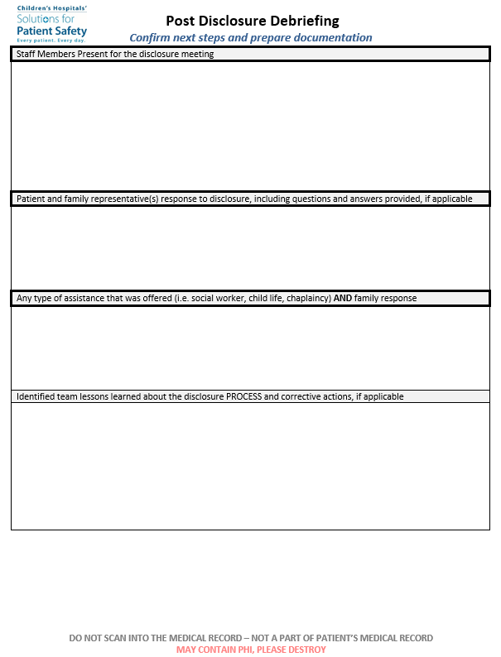
Complete: Post Disclosure Debriefing
How would you complete this worksheet?
Notes:
Note: Expected that this is printed for each participant, readable, zoomed, slides are hidden next

Slide 53
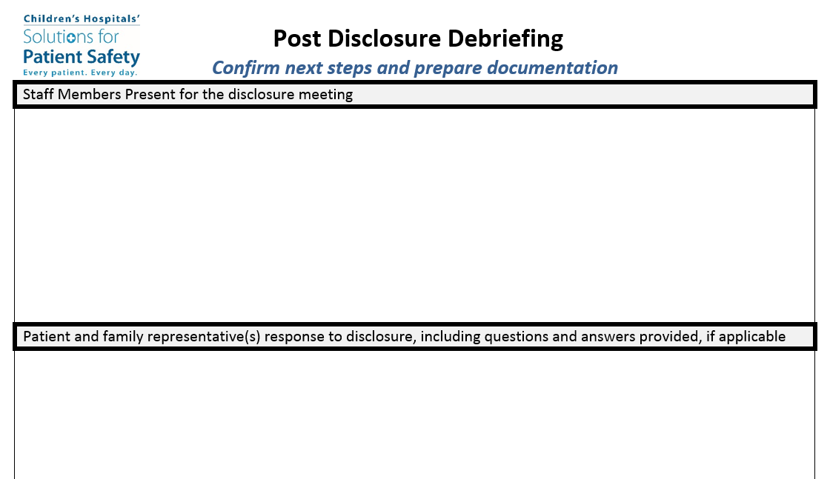

Slide 54
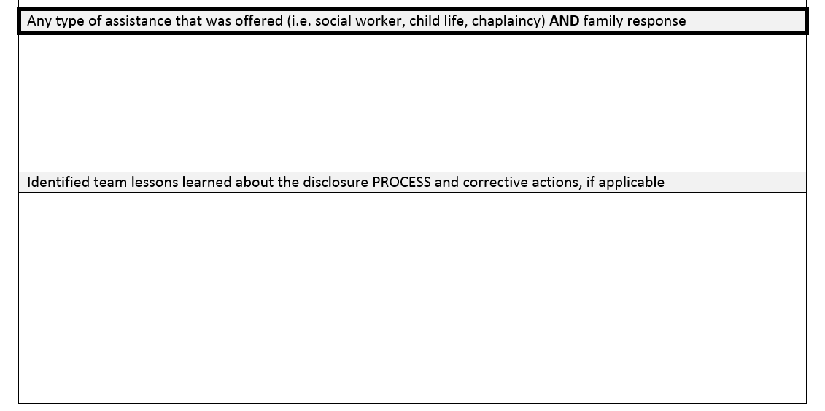

Slide 55
Medical Record Documentation

Slide 56
Medical Record DOCUMENTATION
PURPOSE:
To ensure timely and accurate documentation of the disclosure conversation that meets also meets regulatory requirements
Disclosure Meeting Documentation to include:
Date and time of meeting
Name of spokesperson
Name of patient and family representative(s) present for the meeting
Staff witnesses present for the disclosure meeting
Summary of medical facts related to event
Summary of disclosure
Patient and family representative(s) response to disclosure, including questions and answers provided, if applicable
Follow-up plans, if applicable

Slide 57
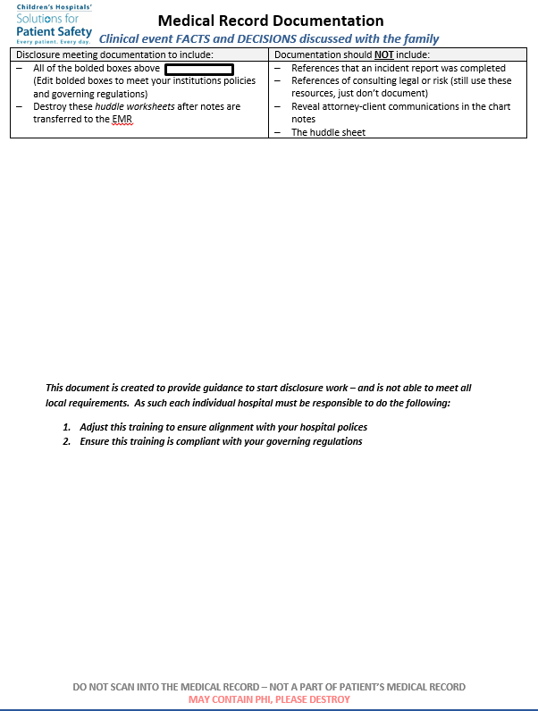
Complete: Medical Record Documentation
How would you complete this worksheet?
Notes:
Note: Expected that this is printed for each participant, readable, zoomed, slides are hidden next

Slide 58
Notes:
This document is created to provide guidance to start disclosure work – and is not able to meet all local requirements. As such each individual hospitals must be responsible to do the following:
Adjusts this training to ensure alignment with your hospital polices
Ensure this training is compliant with your governing regulations

Slide 59
Simulation Role Play

Slide 60
Simulation Ground Rules
Participate
Be on time
Stay on task
Share responsibility for workshop
Listen when others talk
Respect the opinions and attitudes of others
Turn off cell phones and pagers
Use flip chart parking lot

Slide 61
Simulations
Large Group Activity:
Small groups practice each part of process
Case #1
Break into small groups to practice using the Huddle/Checklist
Reconvene large group for reflection and questions
Break into small groups again to practice Disclosure Conversations
Reconvene large group for reflection and questions
Break into small groups to practice Team Debriefing
Reconvene large group for reflection and questions
Small Team Break Out Group:
Small groups run scenario from beginning to end
Case #2
Practice using the Huddle/Checklist
Practice Disclosure Conversation
Practice Team Debriefing
Reconvene small groups for reflection and questions

Slide 62
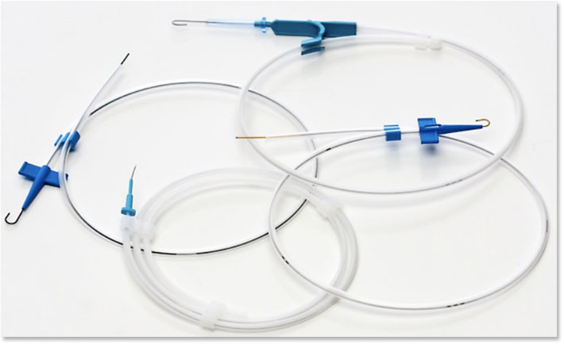
Simulation Case #1: Retained Guidewire
Goal | To practice the empathetic and apologetic medical disclosure process
Objectives | Employ the huddle tool in creating a disclosure plan Practice the disclosure conversation with the simulated parents
Patient Information | Name: Jimmy Smith Age: 10 years
Reason for the Encounter | Current status: Admitted to PICU post trauma for severe intracranial injury. On day 3 the PICU attending receives a call from the radiologist that a retained guidewire is noted for the first time on CXR. Radiology does not have an explanation at this time as to why this was not seen earlier. PICU attending calls the anesthesiologist to inquire about the insertion. Anesthesiologist states that she did not have an assistant at the time (left the room due to another emergency surgery) and the patient had some increased bleeding due to dilutional coagulopathy and that this may have cause her to be distracted. She also felt there was a hurry to get the patient to the PICU. The patient will need to go to the cath lab for removal of the guidewire. Patient has not experienced any apparent harm from the retained guidewire except requiring an intervention for retrieval. Allergies: NKA Medications: N/A History: Admitted for intracranial injury post trauma. Current Life situation: Lives with mother and father
Your Role | Physician and designated healthcare team members
Your Tasks | Develop a disclosure plan and communicate to the parents in an empathetic manner about what occurred

Slide 63
Simulation Case #2: Weight/Med Dosing Error
Goal | To practice the empathetic and apologetic medical disclosure process
Objectives | Employ the huddle tool in creating a disclosure plan Practice the disclosure conversation with the simulated parents
Patient Information | Name: Jenny Parsons Age: 3 year old
Reason for the Encounter | Current status: Admitted for neck abscess for antibiotics and I&D Allergies: NKA Medications: Clindamycin and IV fluids History: 3 year old admitted for neck abscess to receive antibiotics and I&D of abscess. As the hospitalist, Dr. Kerns receives a call from anesthesia that the weight of the toddler in the in-patient record is 31.7kg but the outpatient weight in the clinic was actually 13.7kg. The clindamycin dose and the IV fluids dose were calculated for 31.7kg. The patient has received 2 doses of the Clindamycin. In discussion with the pharmacist it is agreed that the next dose will be held but he does not expect the patient to have problems as it is still within the dose limits for the child and the extra fluids she received will help the elimination of the drug. The pharmacist notes that most reactions to clindamycin are not dose related. The child does not have any detectable harm and is acting normally and required no analgesia overnight. Current Life situation: Lives with mother and grandmother
Your Role | Physician and designated healthcare team members
Your Tasks | Develop a disclosure plan and communicate to the parents in an empathetic manner about what occurred

Slide 64
Simulation Case #3: Wrong Patient Scheduled
Goal | To practice the empathetic and apologetic medical disclosure process
Objectives | Employ the huddle tool in creating a disclosure plan Practice the disclosure conversation with the simulated parents
Patient Information | Name: Michaela Smith Age: 2 years
Reason for the Encounter | Current status: Pre-procedure, awake, alert in no distress Summary: Michaela is a 2 year old with unilateral vocal cord paralysis and dysphagia that developed after prolonged intubation one year ago for complicated parainfluenza. She was to return today for an outpatient swallow study. Current status: Dysphagia on honey thick liquids History: At one year of age developed unilateral vocal cord paralysis and dysphagia after prolonged intubation due to complicated parainfluenza. She has been on honey consistency liquids since. Current Life situation: 2 year old with unilateral vocal cord paralysis and dysphagia otherwise doing well. | What Happened: Michaela Smith (DOB 7/11/2014) was mistaken for Michael Smith (DOB 8/11/2004) and scheduled for an outpatient EGD rather than a swallow study. This was not discovered at initial check-in to outpatient testing area This was not discovered by the nurse verifying the procedure with mother The gastroenterologist, Dr. Murray, noted the error when she came to talk with Michaela's mother. Dr. Murray was expecting to find 10 year old Michael Smith, not a two year old child. Dr. Murray then confirmed that Michael Smith was not scheduled and that Michaela Smith had been scheduled in error. Michaela Smith did not have an EGD done.
Your Role | Physician and designated healthcare team members
Your Tasks | Develop a disclosure plan and communicate to the parents in an empathetic manner about what occurred

Slide 65
Simulation Case #4: PIVIE
Goal | To practice the empathetic and apologetic medical disclosure process
Objectives | Employ the huddle tool in creating a disclosure plan Practice the disclosure conversation with the simulated parents
Patient Information | Name: David Neville Age: 5 years
Reason for the Encounter | Current status: Known sickle cell disease now with sickle cell pain crisis and IV for IVF's, ketorolac, morphine and diphenhydramine. Summary: David is a 5 year old with known sickle cell disease admitted in sickle cell pain crisis who requires IV for IVF's, IV ketorolac, morphine PCA and diphenhydramine. Today is day 3 of hospitalization. Peripheral IV infiltration right arm discovered requiring discontinuation of IV and elevation of arm for two hours. Allergies: None. Possible adverse reaction to morphine (pruritis controlled with diphenhydramine) Medications: Ketorolac, Morphine PCA, Diphenhydramine History: 5 year old with sickle cell pain crisis admitted to Hem/Onc floor for management requiring IV. | What Happened: David 5 year old admitted for sickle cell pain crisis. 22 gauge IV catheter placed in right hand; all subsequent fluids and IV meds given through this IV IV maintenance fluids (D5 1/2 NS with KCl 20 mEq/L) started IV Ketoralac scheduled every 6 hours started IV Morphine PCA started David developed occasional itching; IV Diphenhydramine started On Day 3 complained of pain at IV site; noted by off-going nurse IV had been checked qhour, but multiple layers of tape covering site At shift change, IV site evaluated by off-going and on-coming nurse; on-coming nurse noted right arm to be larger, hard and cold. Right radial pulses also noted to be decreased. IV immediately removed, right arm elevated above head Re-evaluation right arm two hours later: decreased edema, normal radial pulse, no functional deficits.
Your Role | Physician and designated healthcare team members
Your Tasks | Develop a disclosure plan and communicate to the parents in an empathetic manner about what occurred

Slide 66
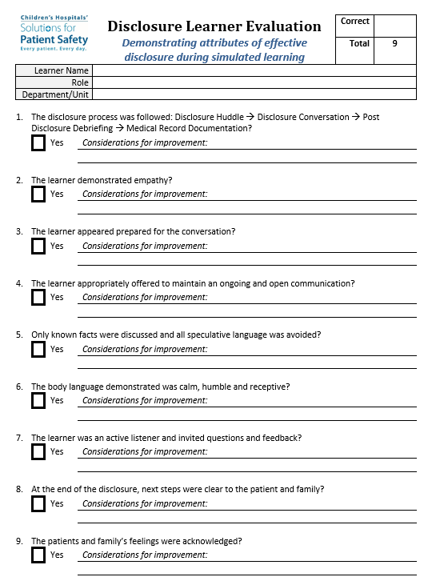
Learner Evaluation

Slide 67
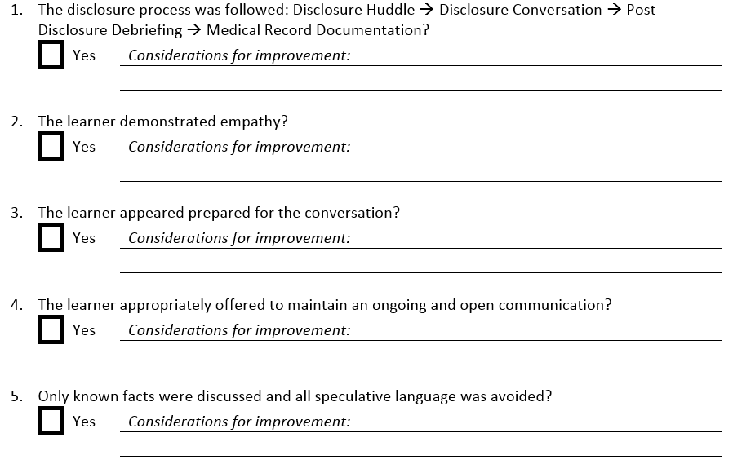

Slide 68
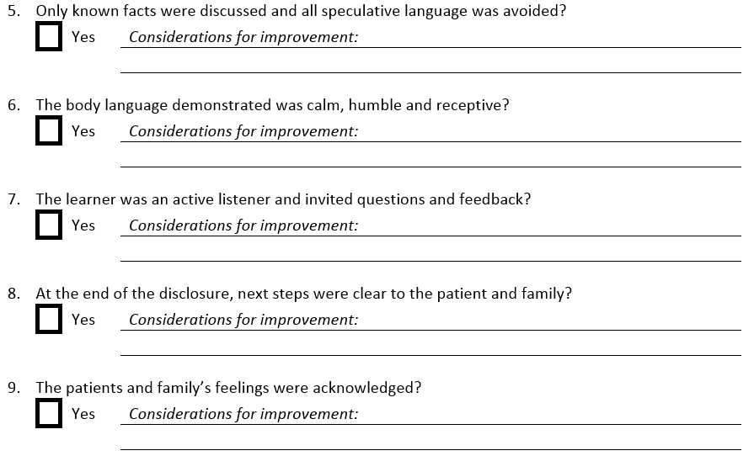

Slide 69
Disclosure Training slides
Closing Comments . . .

Slide 70
Disclosure
Disclosure is NOT an event . . .
It is a PROCESS

Slide 71
Disclosure
To health care providers . . .
“We know you make mistakes, we all do. However, no matter how difficult, no matter the hurdles – continue the conversations.”
A father’s perspective after the loss of
his son due to a medical event

Slide 72
Disclosure
“You cannot undo some things, but you can make sure you do the next things right.”¹
Disclosure is NEVER WRONG.²
¹ Apology and Disclosure: A Father’s Perspective – Opportunity, James Padilla, JD
² Disclosure of Unanticipated Events in 2013, Prologue to the Re-Release of the Three ASHRM Disclosure Monographs, Geri Amori, PhD, ARM, CPHRM, DFASHRM

Slide 73
Disclosure
The true measure of a successful and effective disclosure is NOT the avoidance of malpractice litigation, but rather . . .
The re-establishment of patient and family trust
The conveyance of ethical behavior (to include a patient-centered care philosophy of openness and transparency)
The fulfillment of the caregiver’s obligation to the patient
Learning from, and not repeating, mistakes
Showing healthcare’s humanism to the community at large
Notes:
Why patients/families sue: (1) suspect cover-up, want answers; (2) need help with access to care and financial resources; and/or (3) anger / revenge.
It is not the goal of disclosure to prevent lawsuits. Disclosure is not now, and never will be, a risk management technique.
QUESTIONS ??
Present “next steps” for disclosure training (e.g. – simulation / practice scenarios / PBLDs)

